Slide 1


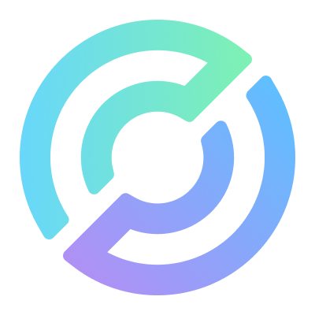
Intent Pay
No need to understand blockchain

Slide 2
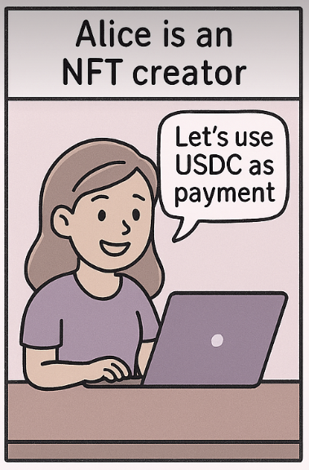
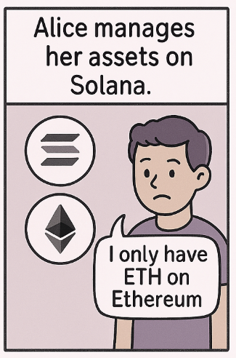
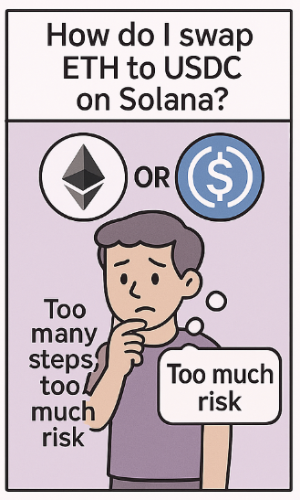
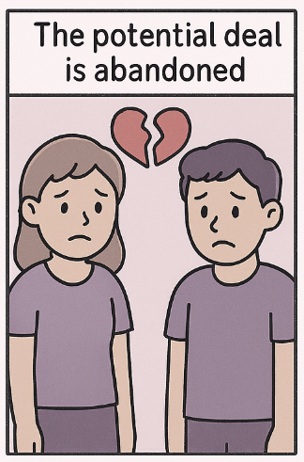
Scenario

Slide 3
The Problem
Web3 is too complex for the average user
Wallet setup & gas tokens are major barriers
Cross-chain swaps require multiple tools
Users fear getting scammed or making mistakes

Slide 4
Our Solution
IntentPay: Lets users send crypto payments or buy tokens without needing a wallet or understanding blockchains.
IntentWallet: A personal smart wallet created for the user that lets them access the full power of DeFi, without requiring them to manage private keys, passwords, or gas tokens.

Slide 5

User Journey: IntentPay
Authenticate with World App
Pick destination chain/token
Enter recipient
No Wallet Needed
Pay with WLD or USDC
Cross-Chain
Token-less for You
Simple UX
Pay with WLD/USDC.e
System auto-swaps, routes, and delivers
Notes:
No Wallet Needed: You don’t need MetaMask or Phantom. It just works inside World App.
Pay with WLD or USDC: Use tokens you already have from World App
Cross-Chain: Works across Ethereum, Base, Arbitrum, Solana, etc.
Token-less for You: You don’t need to have gas tokens like ETH or MATIC
Simple UX: Just choose what to send and to whom. No blockchain knowledge required

Slide 6
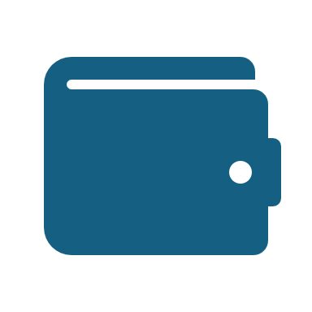
User Journey: IntentWallet
Authenticate with World App
Modular Wallet created
Fund with USDC
Self-custodial:
No passwords
Gas-free
Multi-chain ready
Swap, transfer, use DeFi
Gas-free + cross-chain ready
Notes:
Self-custodial: The user owns the wallet — it's not held by a company.
No passwords: Authenticated using World App identity (Wallet Auth via SIWE)
Gas-free: All transactions use USDC (via Circle Paymaster), no need to hold ETH/MATIC/etc.
Multi-chain ready: Works across Base, Arbitrum, Avalanche, etc.

Slide 7


How It Works
World Payment
Pay USDC/WLD
Modular Wallet
User-side
Developer-side
Smart treasury + route optimization engine
Circle Paymaster
CCTP v2
1inch Fusion+

Slide 8
IntentPay
No Wallet Needed: You don’t need MetaMask or Phantom. It just works inside World App.
Pay with WLD or USDC: Use tokens you already have from World App
Cross-Chain: Works across Ethereum, Base, Arbitrum, Solana, etc.
Token-less for You: You don’t need to have gas tokens like ETH or MATIC
Simple UX: Just choose what to send and to whom. No blockchain knowledge required

Slide 9
IntentWallet
Self-custodial: The user owns the wallet — it's not held by a company.
No passwords: Authenticated using World App identity (Wallet Auth via SIWE)
Gas-free: All transactions use USDC (via Circle Paymaster), no need to hold ETH/MATIC/etc.
Multi-chain ready: Works across Base, Arbitrum, Avalanche, etc.

Slide 10
Business Model

Slide 11
Vision
我們正在打造一套基於 World App mini-app 生態系 的「Intent-based 跨鏈支付模組」，透過 1inch 聚合 DEX、跨鏈協議 CCTPv2 與 Circle Modular Wallet 技術，讓使用者在無需理解鏈與幣種的情況下，一鍵完成任何資產的任意支付，並實現自主資產管理。

Slide 12
World App Mini App + Intent Payment
我們透過 Worldcoin 的 Mini App 架構，實作一個原生整合的 World Payment 體驗入口。
使用者只需發出簡單「Intent（支付意圖）」，例如：「我要用我有的資產，支付 10 USDC 給某個 Solana 地址」系統自動處理：跨鏈、換幣、發送，無需用戶理解所持資產與目標資產是否在同一鏈上。

Slide 13
1inch 聚合器 + CCTP V2
多鏈最佳化 Intent Pay
我們作為中介撮合者，整合：
1inch 聚合器：找出最佳交易路徑與價格（支援多鏈 DEX）
Circle CCTP V2：用於精確、高安全性地橋接 USDC 到目標鏈
這樣就能讓用戶用任意資產（ETH、ARB、MATIC、BNB 等）支付給任意鏈上收款人（例如 Solana 上的 meme 幣），無需自己做換幣與橋接操作。
我們在過程中收取微薄手續費（例如 0.3~0.5%），作為 Intent 撮合與執行服務費。

Slide 14
Circle Modular Wallet
跨鏈資產統一檢視（即使資產散落各鏈）
可與 World ID 綁定實名／人類身份，提升安全與信任
這讓用戶不再需要記住多條鏈的私鑰、助記詞，也不怕資產遺失或遺忘
Intent Wallet

Slide 15
用戶零感知、多鏈任意支付 不懂鏈、不懂幣也能完成支付
Intent 撮合 + 最佳價格執行: 結合 1inch + CCTP 的路由與效率
資產由 Modular Wallet 管理: 提供安全、可擴展、可與 World ID 整合的錢包方案
商業模式: Intent 撮合收取低額手續費，按交易量穩定營收

